Slide 1
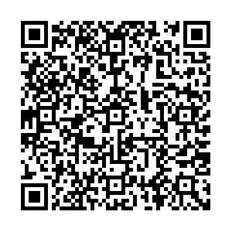
SCHOLARSHIP MEETING #1 - WELCOME!
Quick Link to Career page/Finance & Awards:

Slide 3
Eligibility:*Graduating students*Canadian Citizenship, Permanent Resident or Landed Immigrant Status, Protected persons/Refugees will fulfill most requirements and criteria. **International Students do not meet this requirement. There are a few sources of funding for International students via government agencies, post-secondary institutions and other donors.
INTRODUCTION
AWARDS/DEFINITIONS
Major Awards (High value/Merit based)
Post- Secondary Entrance Awards
Service Based Scholarships
Government/Ministry Awards District Authority Awards
Centennial Local Scholarship Package (2024) Meeting #2 in February. Due April 11th, 2024
DEFINING NEED
Cost of tuition Financial Aid
APPLICATION STRATEGIES
Personal Essay Personal Profile
POST SECONDARY APPLICATIONS

Slide 4
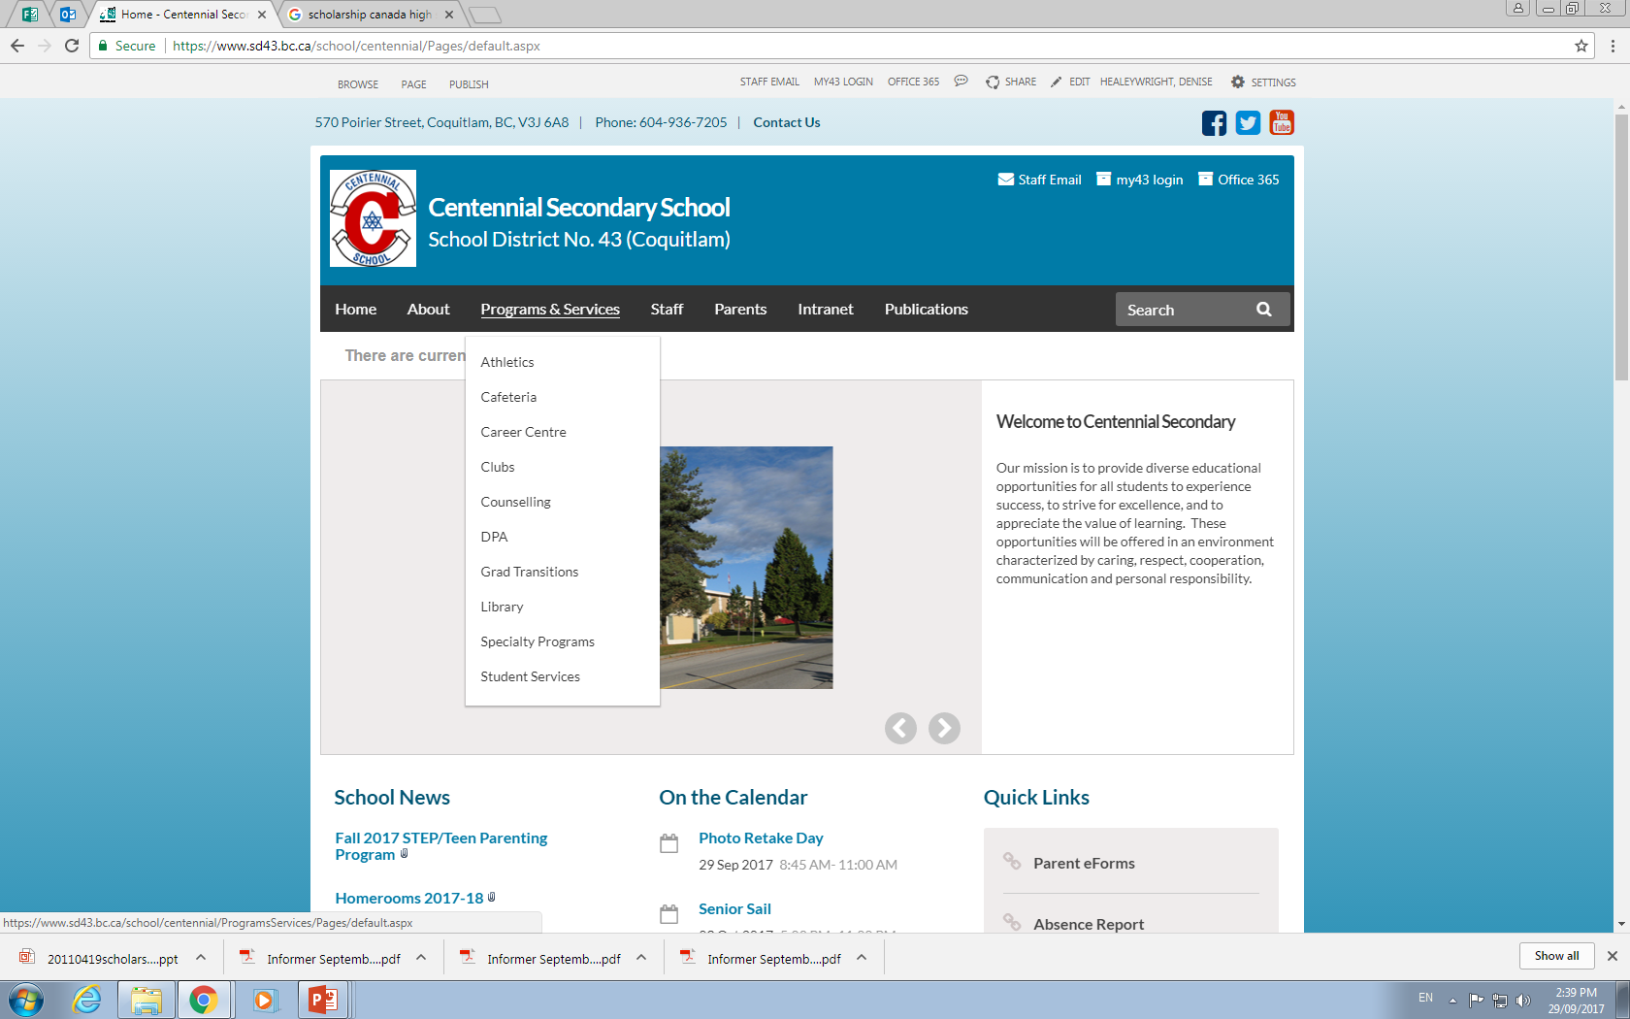

Slide 5
Select buttons for information and links regarding Financial Aid & Awards (Scholarships/ Bursaries)
Also Employment, Volunteering and Post-Secondary Information and info sessions.

Slide 6
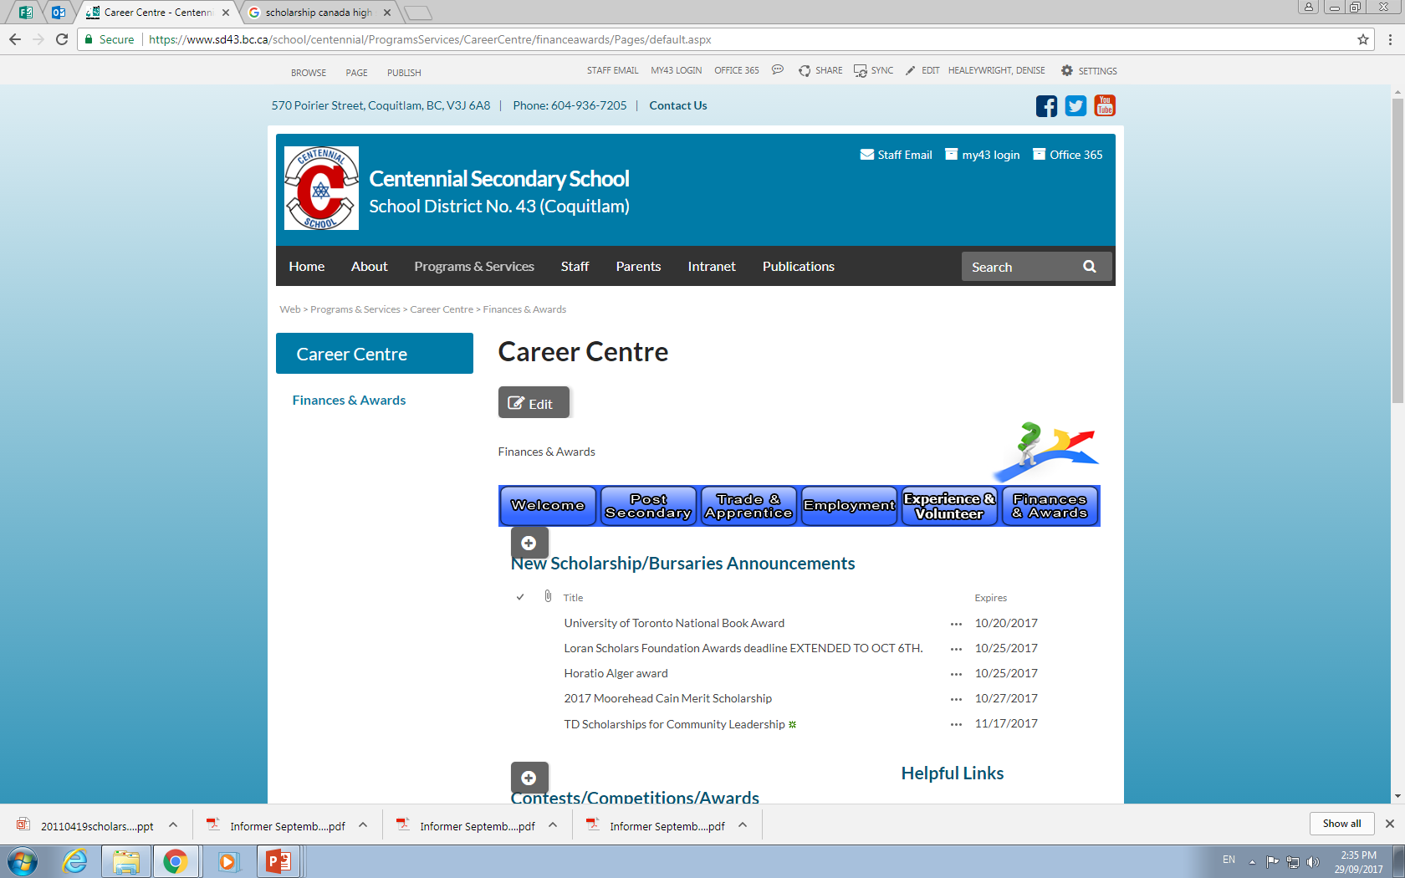
SCHOLARSHIPS ARE LISTED here
Click on each award
listing for details!

Slide 7
FAQ’s
WHEN should I apply for scholarships?
Start research NOW for Entrance Scholarships and Major Awards
However, many scholarship deadlines occur within the months of February-May

Slide 8
SCHOLARSHIPS, BURSARIES & AWARDS - AN OVERVIEW Financial aid is not the same as Financial need
Financial Aid:
Monetary support, as a loan or scholarship, that is used to pay for school, especially higher education:
“I don’t qualify for need-based financial aid, so I’ll have to hope I’m awarded a merit-based achievement, community service and/or leadership awards.” Financial Need
The difference between the cost of an educational program and what the student can afford to pay. One's financial need may qualify one for grants, scholarships, or low-interest loans. Otherwise, the student must borrow or save. Parental & student annual income is considered.

Slide 9
Sample Costs of Post Secondary
College:
Douglas College: First year full time Tuition can range from $5,000 to $13,000 per year including Fees & Books- depending on choice of program and whether you live at home.
University:
UBC approx $22,000 per year full load, (including living on campus (shared), meal plan) books fees and living expenses.
Private colleges and universities are usually twice the tuition of public institutions.
International Tuition fees are much higher than Domestic fees.

Slide 10
Post- econdary Funding:
Student Aid BC (re-payment)
For student loans there is an expectation that YOU and your parents will contribute some funds to your education! Talk to your parents about this.
Research the website http://www.studentaidbc.ca
Bank Loans (re-payment)
Savings from part-time and/or summer employment
REF (Registered Education Fund) or money from family
Scholarships
Awards
Bursaries (usually based on need)
FUNDING your education may require a combination of these examples!!

Slide 11
PROVINCIAL SCHOLARSHIP PROGRAM
BC Pathway to Teacher Education Scholarship $5,000
(20 awards available to students entering a Faculty of Education program)
BC Excellence Awards $5,000 One nominee
There are 55 BC Excellence Scholarships available to recognize well-rounded B.C. graduates. Winners will have demonstrated service and leadership, both at school and in their communities, and shown aptitude and commitment to their chosen career paths. They will receive a $5000 scholarship voucher to use for post-secondary tuition. DUE: Feb 15th
BC Achievement Scholarships $1,250 Automatic Students do not apply.
Recognize the top 8000 graduates in the province. The Ministry will determine recipients based on achievement in Grades 10, 11, and 12 courses that satisfy 2004 Graduation Program requirements, including elective courses. CLE will not be included.
A cumulative average percentage will be calculated and form the basis for determining winners, who receive a $1250 scholarship voucher to use towards their tuition.

Slide 12
District/Authority Awards $1250 - Up to 35 awarded at our site –
Apply within our local scholarship package in the spring
The application will require teacher signature which verifies that you EXCEL in the focus area. You can excel in two areas, but only one may be awarded. WINNING STUDENTS RECEIVE A VOUCHER IN NOVEMBER AFTER GRADUATION PAYABLE TO THE PSI.
Superior Achievement/Excellence in one of the following areas:
• Fine Arts (Fine and Performing Arts)
• Applied Skills
• Trades and Technology
• Physical Activity (classes and/or school-based teams and/or provincial/national level)
•Curricular Second/international Languages
•District / Curricular Technical & Trades Training
•School & Community Service (min 150 hours to apply)
• Indigenous Languages and Culture
https://www2.gov.bc.ca/gov/content/education-training/k-12/support/scholarships/provincial-scholarships
(Applications available included with local package in February from Mrs. HW due April 11 2024).

Slide 13
Major Scholarships & Major Entrance Scholarships (Merit based) Deadlines are early in the school year Speak to your counsellor if you would like to be nominated. If you meet the criteria for these awards, and do not require a nomination – APPLY & follow instructions! This year UNIVERSITIES AND COLLEGES ARE URGING STUDENTS who meet the criteria TO APPLY FOR ENTRANCE AWARDS. Plenty of funding is available!! Check your institutions for available awards for incoming students.
Sample Awards:
Loran Awards (October) Community service no nomination required
Horatio Alger Awards (October) Financial need
U of T National Book Award (October) (1) nomination/Merit
Queen’s University Entrance Award Chancellors (December) (1) Merit
Lester B Pearson Int’l Student Scholarship (November) (1) Merit
Schulich Leader Scholarships (January) (1) Apply internally to be our nominee
Cmolik (January) (1) Apply internally to be our nominee
University of Western Ontario (February) Merit

Slide 14
Loran Scholars program www.loranscholar.ca/apply Value: up to $100,000, $5,000 and $2,000 awards available.
Eligibility: Must be a graduating student, have a minimum cumulative average of 85%, over the past 3 years be a Canadian Citizen or permanent resident, be at least 16 years of age by Sept. 1 of the following year.
Loran Awards are only tenable at participating universities in Canada, but finalist and provincial awards are tenable at any accredited public university in Canada.
Criteria: Must have outstanding service, leadership and character (integrity, humility, kindness, courage, tenacity and personal autonomy) and demonstrated a commitment to serving and improving their community/school.
DUE: OCTOBER 11 2023

Slide 15
University of Toronto Book Award and U of T National Scholarships
Centennial can nominate one student for the U of Toronto Book Award. If you intend on applying U of T and would like to be nominated for the Book Award, submit a brag sheet Mrs HW. (Friday Oct 9)
For the National Scholarships at U of T, you do not have to be nominated to apply.
15 Scholars (winners/full ride) and 10 Arbor Scholars (runners up- ~10K)
visit: www.uoft.me/national-scholarship
Deadline to apply Oct 20/2022.

Slide 16
Queen’s Univ. Major Admission Awards
Deadline to apply for MAA: Dec. 8, 2023
Must apply to Queen’s Univ. no later than Nov. 20, 2023 Go to https://www.queensu.ca/studentawards/admission-awards/major-admission-awards
QUARMS – Queens U Accelerated Route to Medicine is no longer linked to Chancellors Scholarship application- The goal of QuARMS is to offer a carefully selected group of up to 10 outstanding Black and/or Indigenous peoples that are graduating high school, an exciting and innovative 2-year pathway that culminates with application for admission to the 1st year of Med School at Queen’s.
Apply via OUAC by Dec. 1 https://meds.queensu.ca/academics/quarms

Slide 17
UBC Major Entrance Awards
UBC Presidential Scholars Award (academic/leadership)
Students will be automatically considered for this award if they apply to UBC through the online application by December 1 each year
Centennial Scholars Entrance Award 80K (based on financial need and still be a strong academic student who is involved and meet all UBC admission requirements)
Application is required and due December 1
Application form (open Oct. 1)
Scholarships for international students: apply to UBC by Jan. 15, 2024 to be automatically considered.
Awards for Aboriginal students: must self-identify on UBC application.

Slide 18
SFU Entrance Awards
High School Entrance Scholarships, Awards, and Bursaries are only available to applicants applying to SFU for the Fall.
The Fall 2024 Undergraduate Scholars Entrance Scholarships application is open October 1 - December 15, 2023.
The Undergraduate Scholars Entrance Scholarship (USES) Program is designed to attract both domestic and international high school applicants who demonstrate potential to enrich the university community through ongoing academic and community contributions. The USES Program has a number of scholarships that range in value from $20,000 to $140,000. Eligible applicants will be considered for all USES Program scholarships based on one application.
Other Entrance Scholarships may require individual applications.

Slide 19
What can you do now – prepare and start:
Register for virtual and in-person POST-SECONDARY INFO SESSIONS. Post-Secondary reps are a wealth of information about Financial Aid programs and Entrance Awards. Research tuition costs and visit financial aid pages.
Reminder: Each Post-Secondary Institution offers its own listings of scholarships and bursaries for applicants.
Check the Career Centre website on a regular basis.
Read the Centennial Today, Follow us on Instagram @cent43careercentre
Maintain a scholarship file.
Make sure you have one or two referees/references.
Complete your brag sheet to provide to them.

Slide 20
Notes about applying: Follow the instructions! Do not apply if you do not meet ALL criteria.
The number one complaint about applications -
is students DON’T ANSWER THE QUESTION!
Show the donor how you meet the criteria.
Prioritize your applications by deadline and the expected value
Use a calendar and checklist to get organized
Tailor your application /essay to the donor’s goals and criteria
Know your competition/candidate pool: is it SCHOOL-BASED, LOCAL, PROVINCE WIDE, NATIONAL? (Centennial vs Coquitlam vs BC vs Canada)
Local/Community awards have the best odds!
Notes:
Expected value is the product of the chances of winning the scholarship with the amount you get if you win the scholarship. A less competitive scholarship with a lower top prize may have a higher expected value because your chances of winning are better.
The accomplishments resume can help you complete the scholarship application and improve your awareness of your strengths and interests. It can also help your teachers write better letters of recommendation.

Slide 21
The process is ongoing all year:
Search: which awards match your criteria?
Apply, apply, apply! Be aware of deadlines!
Be clear and concise in your application. Use word counts to your advantage
Have you essay proof-read,and seek feedback well in advance of the due date. Edit. Edit,. Edit.
Do not use companies like Grant me – Donors may disqualify/penalize you.
In the essay, relate to the donor. This is your time to shine! Answer any questions. Highlight what experiences you have that make you stand out!

Slide 22
Where can you find scholarships?
The Career Centre Website - Scholarships are updated and available on in the Financial Aid page.
Financial Aid Booklet will be uploaded on the Financial Aid page on the Career Centre site.
The Centennial Today, Career Office, Bulletin Boards, School App
Sign up for a variety of search engines – Links on career site
Ask your parents/co-workers/friends about scholarships they may know of. (Unions, Community clubs, Sport associations, Cultural etc.)

Slide 23
Strategies for Winning Scholarships
Overall, 25% of graduating students never apply!
It gets easier after your first few applications!
Even among talented students, winning money involves a bit of luck, not just skill
To win more scholarships, apply to more scholarships, but only if you qualify and meet all criteria!
Essays can be reused and tailored to each new application
Notes:
It is very difficult for scholarship sponsors to choose between two extremely talented finalists for a scholarship, so the decision can often be arbitrary. Often there is no wrong choice for a winner. Skill gets you selected as a finalist, but the final choice of who wins may be purely random. So applying to more scholarships (for which you are qualified) will increase your chances of winning a scholarship.

Slide 24
Writing a Winning Scholarship Essay or Personal profile.
Answer the essay question orally and transcribe the recording
Use an outline to organize your thoughts
Give examples and be specific
Personalize your essay and be passionate! Shine!
Write about something of interest to you
Talk about your impact on other people and the impact of your experiences
Edit, Edit, Edit
And to repeat…Answer the questions!!
Notes:
Most people can speak and think at a rate of 100 to 200 words per minute, but type or write at a rate of 35 to 60 words per minute. The act of writing interferes with the flow of thought. After you transcribe the recording, you can revise the essay to add structure through an outline of your thoughts. Such an essay will be more fluent and passionate, making it more interesting and lively.
You should proofread a printed copy of the essay because it will be easier to find errors when you are looking at the essay in a different format. Don’t rely too much on the spelling and grammar checkers that are built into the word processing software, as these programs miss a lot of errors, such as valid-word spelling errors (e.g., its vs. it’s, though vs. through, principal vs. principle).

Slide 25
Grade 12 is your best opportunity for a scholarship! There will never be a time with more opportunities and less competition than your grad year.
A scholarship search is…
NOT “quick and easy.” It can be a lot of work!
Expect to spend several hours finding leads and researching, editing your essay, filling out applications, asking for references.

Slide 26
Start now. Please do NOT be the student who comes to see me in May and asks about scholarships! Most will have closed by then.
Scholarship funding is… NOT fast money!
Plan ahead! Talk to your parents now about your educational costs.
There is usually a 4 to 6 month delay between the time you start and the earliest you might receive funding/voucher.
1st semester tuition and fees will be due (usually in full) in August.

Slide 27
If you spend 3 hours on a scholarship and win $1,250 it is equal to 78 hours of work at minimum wage job.
There are no guarantees!
You could do all this work and receive nothing.
Anyone who “guarantees” scholarship money or asks for money up front is probably a scam artist. Beware!

Slide 28
Success is possible!
Centennial grads win major awards:
In 2020 we had a Schulich Leader winner $80,000. In June 2022 we had a U of T Arbor scholar $20.000. In 2023 we had: Cmolik (40K) Beedie 30K and SFU Uggla (full ride)
Most grads who apply to our local package and/or District Authority Awards and meet all criteria will win scholarship funds.($1250)
For Bursaries, financial need is usually in the criteria. Need is based on annual family income and/or circumstances. If you are unsure whether you qualify for financial need bursaries see Mrs. HW or your counsellor.

Slide 29
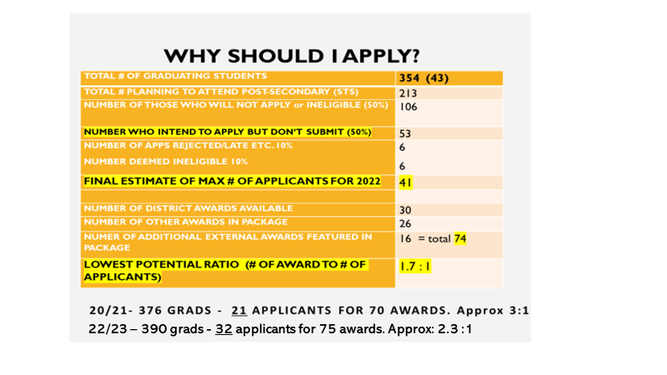

Slide 30
Fall 2024 Application Timeline - BC Schools Apply via Education Planner BC Application system (create account) MOST APPLICATION PORTALS ARE OPEN NOW Douglas College – Applications OPEN Oct. 3 SFU – Applications OPEN Oct. 1, 2022 Entrance Scholarship deadline Dec.15, 2022. Application deadline is Jan 31, 2023. UBC – Early Application Deadline is Dec. 1, 2023 to be considered for the UBC Major Entrance Scholarships. Final Deadline TO APPLY is Jan. 15, 2023. UVic –Application deadline is Feb. 28, 2023. BCIT – Applications open Oct 1 until full or by deadline date. Apps for trades programs accepted all year. (rotating). BCIT has its own application. STS permission is still needed. (Many BCIT programs are competitive. Apply early! Many programs do not accept direct high school applicants & require post-secondary credits to apply)

Slide 31
Out-of-Province Applications
Universities in Alberta –https://www.applyalberta.ca/pub/
OUAC Ontario University Application Center–
apply EARLY (November) Go to www.ouac.on.ca/ouac-105/ (OPEN Now – create your account)
USA College Applications via the Common App Apply to college with Common App | Your future starts here

Slide 32
Reminder: Deadlines are set in STONE !!
Internal deadlines set by your school
College & University application deadlines
Online/Distance course completion deadlines
Standardized test deadlines TOEFL, SAT, IELTS etc.
Transcript request & BCeID#, STS deadlines

Slide 33
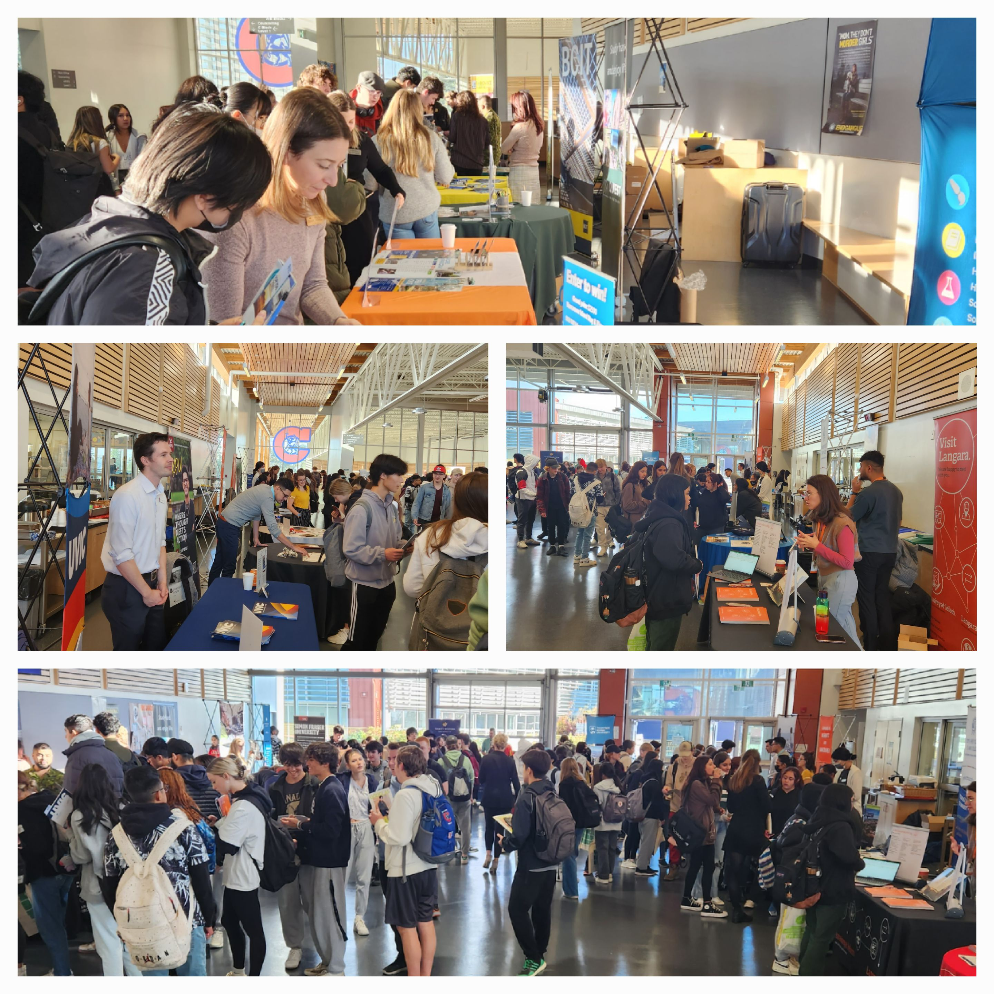
Upcoming EVENTS
Douglas Campus Info Fairs
Oct 17 Coq & Oct 19 New West –
Check which programs each night
BCIT BIG INFO ONLINE OCT 18
SFU at Centennial Student/Parent night: Oct 18 , 7pm THEATRE
PSBC FAIR OCT 30TH 9-11 AM
FIRE ACADEMY INFO SESSION NOV 7
SFU Beedie at Centennial Nov 15 lunch
Experience VCC Open house Nov 15 9 – 3pm Broadway

Slide 34
Good Luck! Thanks for attending!

